Slide 1

Washington State Independent Auto Dealers Association
Excise Tax Update 2020
Ken Krous – Assistant Director Audit Division

Slide 2
Outline
Department Overview
Overview of B&O tax and common issues
Overview of RST and common issues
Miscellaneous Items
Use Tax
New Legislation
Audit Process (Time Permitting)
Resources

Slide 3

Ask questions at any time

Slide 4
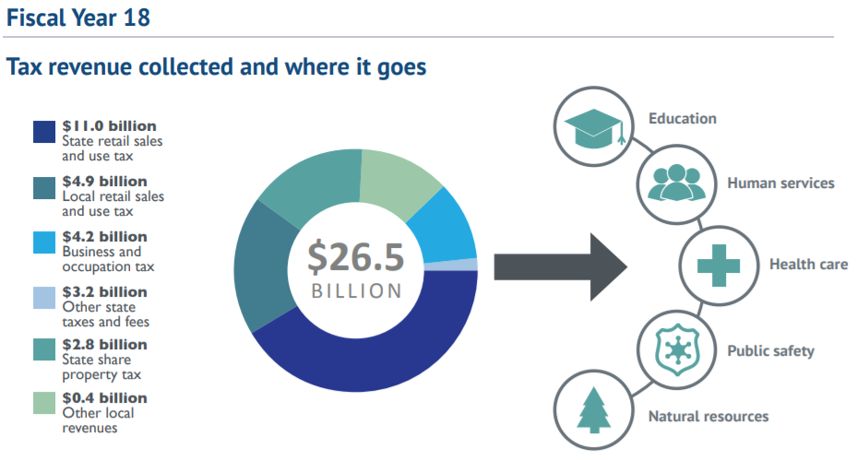
Department of Revenue
Legislature passes tax laws
Department collects taxes in accordance with the laws

Slide 5
Department Overview
Vision
Achieve the highest level of voluntary compliance.
Mission
  Fairly and efficiently collect revenues and administer programs to fund public services.
Role
  Washington State’s primary tax collection agency, overseeing about 60 different taxes
    Collecting over 90% of state General Fund
    tax revenues ($23.8 billion in state and local taxes in 2017)
    Collecting all local sales tax revenue
    Processing 2.15 million tax returns per year
    from over 486,000 businesses
    Process over 523,000 business license applications and renewals

Slide 6
Department Response to COVID
Returns Extensions
Penalty and Interest waivers
Audits timing, extensions, etc.
Re-engagement
Safe Start

Slide 7
What We Do
Audits & Examinations | Taxpayer Education | Other Services
Field Audits Public Works Contract Clearances Desk Examinations Refund Request Verification | Business Outreach Speaking Engagements Consultation Visits | Corporate Dissolutions Voluntary Disclosure Program
Notes:
Conduct: over 6,000 audits/year & PW clearances/year
Number of Refund Requests in FY17:
Amount Requested: $130M
Amount Allowed: $90M
Amount Denied: $40M
Addt’l Amount allowed: $1M
Addt’l Amt Assessed: $900K
Tax Savings per Hour: $3,256
Voluntary Disclosure Qualifications: never registered/never reported, never contacted for enforcement, no evasion/misrepresentation
Quick Stat FY2017: 292 VDAs processed for $22.9 million
All desk exams are limited in scope and qualified to allow for future audit.
PWC: over 7,500 contract clearances processed in FY17, assessing over $8.4 million; Goal to process w/in 60 days, Average = 52 days

Slide 8
Overview of B&O Tax
Gross receipts tax assessed against an entity for conducting business in Washington.
Measured by gross income or gross proceeds of sales
  NOT a tax on net income
  No deductions for cost of doing business
There are nearly 40 different B&O classifications.
12 different tax rates (from .138% to 1.93%)
The appropriate B&O classification depends on the nature of the BUSINESS ACTIVITY.

Slide 9

Recurring B&O Tax Issues
Auction Sales
Nonresident Sales

Slide 10
AUCTION SALES – Exempt if:
The contract with auction house clearly shows that sales are made strictly to licensed dealers
The auction house obtains reseller permits from each dealer
The settlement document provided by the auctioneer to the seller shows purchaser, dealer number and sales price and description of each vehicle sold including make, model, and VIN.
References: RCW 82.04.317 & RCW 82.04.422

Slide 11
Nonresident Vehicle Sales
Sales to nonresidents of WA where delivery occurs in WA
It is a RST deduction. There is NO corresponding B&O deduction because delivery occurs in WA.
Available to residents of any state other than WA and persons from other countries.
Does NOT include:
  Persons who maintain a residence in WA and another state
  Persons who have not established residency outside WA

Slide 12
Nonresident - Documentation
Dealer must obtain, retain, and make available the following documentation to substantiate nonresident sales:
Driver’s License
Secondary Documentation – evidence of OOS address
  Utility Bill, State Income Tax Return, Voter Registration Card, etc.
Buyer’s Affidavit
Seller’s Affidavit
Evidence vehicle will be immediately removed from WA or registered/licensed in state of buyer’s residence.

Slide 13
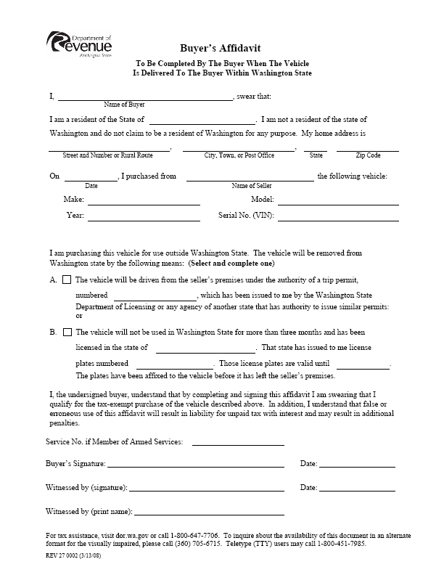

Slide 14
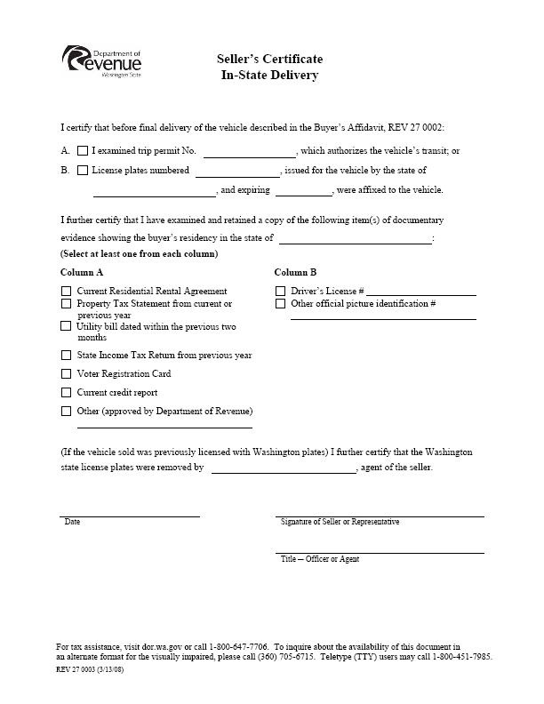

Slide 15
Overview of Retail Sales Tax
Goes hand and hand with retailing B&O
Tax on the consumer (buyer). Collected by the seller and held in trust for the state, and then remitted with the state excise tax return
Seller is liable for the sales tax even if they did not collect it or collected it at the wrong rate.
Sales tax is typically shown as one single rate, but is made up of two parts:
  State rate is 6.5%
  Local rates vary from .5% to 3.9%

Slide 16
Out of State Delivery Sale of Vehicles
Dealer needs two Certificates
  Buyer’s Certificate of Out-of-State Delivery
  Seller’s Certificate of Out-of-State Delivery
Documentation to show Out-of-State Delivery
References
  WAC 458-20-177

Slide 17
TRADE-INS
Property of like-kind
Excluded from selling price (for sales tax purposes) – prior payment of tax not required
May be used for leased vehicles
Leased vehicles traded-in are not available because the purchaser doesn’t own the vehicle being traded-in
No B&O tax deduction
Selling price is not reduced by over/under allowances.
References WAC 458-20-247
Notes:
Over/Under Allowances – often the Invoice price is not what hits the GL rather it is reduced by the over allowance. The trade-in is also reduced by the over allowance, and while this makes the rst a net wash the b&o is understated. Sometimes it is netted on the workpapers prior to hitting the return causing the same problem.

Slide 18
Licensed vehicle trade-in categories
The licensed vehicle categories for "trade-in property of like kind" are:
Motor Vehicles: Cars, trucks, trucks with canopies, motorcycles, motor homes, mopeds, ORVs, and wheelchair conveyances.
Trailers: Boat trailers, utility trailers, animal trailers, commercial trailers, and all other trailers except travel trailers.
Recreational Land Vehicles: Travel trailers, campers, tent-camper trailers, and motor homes.
Boats.
Snowmobiles.
Personal property: Mobile homes, travel trailers, motor homes, tent-camper trailers, and campers.

Slide 19
What can't be traded?
Examples of trade-ins that don't qualify include:
Boats for cars
Farm machinery for trucks
Recreational land vehicles for cars or pickups
Jewelry for motor vehicles

Slide 20
NATIVE AMERICANS
Exempt from sales tax if:
  Sold to federally recognized tribe or member thereof, and
  Vehicle delivered to reservation of which they are a member, and
  Retail Sales/Use Tax Exemption Certificate for Vehicles Sold to Enrolled Tribal Member form must be completed

Slide 21
NATIVE AMERICANS (cont.)
Exempt from B&O tax if:
  Vehicle is on reservation at time of sale, or
  Place of business is on reservation, or
  Sale solicited while on reservation
If we sell to a WA resident that is an Idaho Indian Tribe member and it is delivered onto the Idaho tribe’s reservation, is it exempt of sales tax? yes
References
  Indian Tax Guide Sales of Motor Vehicles - http://dor.wa.gov/Content/FindTaxesAndRates/RetailSalesTax/Indians/IndianTaxGuide/indian_motorvehicle.aspx
  WAC 458-20-192

Slide 22
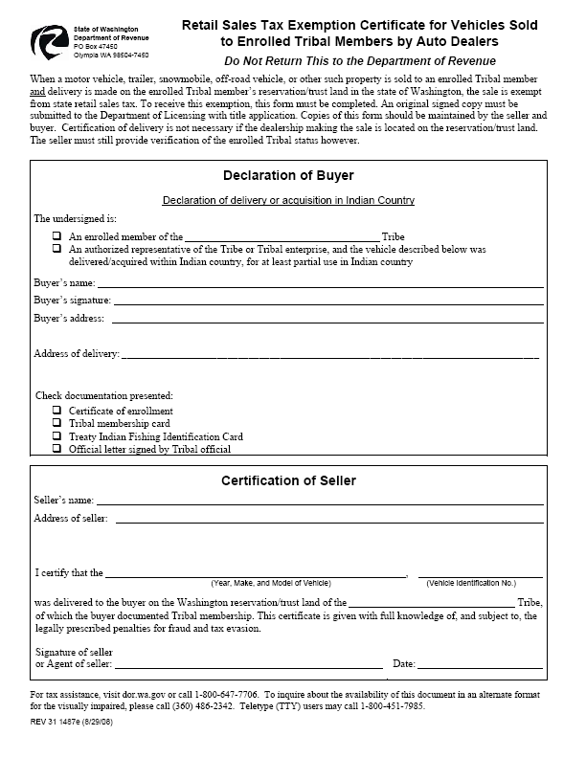

Slide 23
Common Deduction Errors
Double Deductions
  Trade-in Taken on Non-taxable Sales
    Native American Sales
    Military Sales
    Out of State Sales
Trade-in is Greater than the Sale Price
Lack of or Insufficient Documentation
B&O Tax Deduction Taken on Non-Resident Sales

Slide 24
Use Tax
Tax assessed on use of TPP in Washington where RST has not already been paid.
Tax rate follows the retail sales tax rates.
Common items subject to use tax that are overlooked by automobile dealers:
  Advertising Material, Office and Showroom Supplies and Equipment, Parts and Accessories Department, Shop Supplies, Building Maintenance, Mobile Equipment.

Slide 25
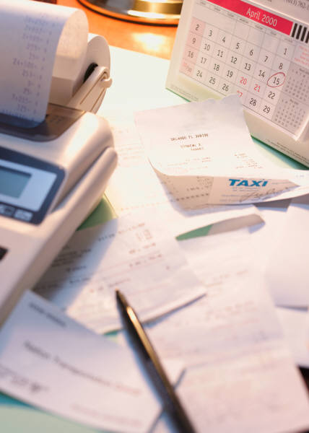
Auto Dealer Specific
Use Tax Issues
Demonstrator and Executive Vehicles
Service Loaners
Parts Vehicles
Internal Charges on Parts Vehicles, Loaners, etc
Promotional Materials

Slide 26
Personal Use of Used Vehicles
Used vehicle dealers who provide used cars to their sales staff or managers for personal use without charge are subject to use tax.
The tax is due on one vehicle per year for each sales person or manager who uses one.
The value for use tax reporting is the average selling price of all used vehicles sold in the preceding year multiplied by 25 percent.

Slide 27
Use Tax Issues Continued
Service Loaners
  100% taxable or
  2% per/month
Parts Vehicles
  Trade-in allowed if 100% option chosen
Internal Charges on Parts Vehicles, Loaners, etc
References WAC 458-20-132 & WAC 458-20-178

Slide 28
Nonresident Sales Tax Exemption
NO changes to the nonresident exemption for vehicle sales outlined in WAC 458-20-177
Applies to Non-Vehicle Sales
The exemption is no longer available at the point of sale. Sellers must charge retail sales tax.
Begins July 1, 2019
Buyers will now apply for a refund from the state
Refunds will only apply to state retail sales tax
Buyer’s can apply for refunds starting January 1, 2020

Slide 29
Why am I Being Audited?
The Department routinely audits businesses to determine whether state excise taxes were reported and paid correctly.
Audit Selection – How was I selected?
  The majority of businesses are chosen at random using statistical methods.
  Also can be selected because of a pattern of inconsistent reporting, improper use of exemptions, history of discrepancies, or tips received.

Slide 30
Audit Focus
Major Focus Areas:
  Income
  Deductions and Exemptions
  Purchases
Major Excise Taxes:
  Business and Occupation Tax
  Retail Sales Tax
  Use Tax

Slide 31
Recordkeeping Requirements
Records should be kept for a minimum of five years
Typical Records Requested
  Income – FITRs, Financial Statements, General Ledger, Sales Journals, Sales Invoices, ETRs and Workpapers, Deal Jackets, etc.
  Deductions – Exemption Documentation, Supporting Workpapers, etc.
  Purchases – Depreciation Schedule, Check Register, Purchase Invoices, etc.

Slide 32
Audit Process
Auditor will contact taxpayer/representative to schedule an appointment.
Taxpayer/rep will gather requested information.
Audit is performed
Auditor will discuss results with taxpayer/rep.
Audit is agreed to OR a manager’s conference is held.
Audit is finalized.
Any adjustment is paid OR appeal is filed

Slide 33
Miscellaneous Audit Topics
Audit Period
  Usually go back 4 year plus the current year (Registered)
Electronic Records
  Consult with the auditor before printing records
Sampling
Confidentiality
  All records provided will remain confidential.
Due Date to Pay/File an Appeal
  DON’T Miss the Due Date. Penalties immediately assessed.

Slide 34

DOR RESOURCES

Slide 35
More Information
Web: dor.wa.gov
Phone: 1-800-647-7706
E-mail: communications@dor.wa.gov
You may also request a written ruling or contact us at:
  Department of Revenue
  Taxpayer Services
  PO Box 47478
  Olympia, WA 98504-7478

Slide 36
Additional Assistance
12 Local Office Locations Around Washington
Telephone Assistance
  1-360-705-6705
  24-hour automated services
  Personal services available Monday through Friday,
  7:30 am to 5:00 pm

Slide 37

Questions?

