Slide 1
STATE OF WASHINGTON OFFICE OF THE ATTORNEY GENERAL

Slide 2
STATE OF WASHINGTON OFFICE OF THE ATTORNEY GENERAL
The views expressed by Mr. Worthy in this presentation are his own and are not necessarily those of the Office of the Attorney General.

Slide 3
MISSION STATEMENT
Mission Statement
The mission of the Consumer Protection Division is to secure, for the people of Washington State, a marketplace free from deceit and unfairness through strong enforcement, effective education, and creative problem solving.

Slide 4
MISSION STATEMENT
Consumer Protection Vision
Businesses compete on a level playing field
Consumer decisions are based on the quality and value of their products and services, and
Consumers receive accurate, complete and timely disclosure of all the material facts and circumstances

Slide 5
Credit & Lease Disclosures
CREDIT and LEASE DISCLOSURES

Slide 6
MISSION STATEMENT
What is “deceptive”?
RCW 46.70.180(1) To cause or permit to be advertised, printed, displayed, published, distributed, broadcasted, televised, or disseminated in any manner whatsoever, any statement or representation with regard to the sale, lease, or financing of a vehicle which is false, deceptive, or misleading.
From the CFPB:
The act/practice materially interferes with ability of consumer to understand a term or condition of a consumer financial product or service (CFPS)

Slide 7
MISSION STATEMENT
What is “deceptive”?
The CPA does not define “deceptive.”
The Washington Supreme Court held that actionable deception exists where there is a practice likely to mislead a “reasonable” or “ordinary” consumer.

Slide 8
MISSION STATEMENT
What is “deceptive”?
The FTC has noted that on-line consumers do not read every word on a webpage and advises advertisers that they must draw attention to important disclosures to ensure that they are seen. This is particularly important when the consumer has no reason to be looking for, and therefore is not expecting to find, a disclosure.

Slide 9
MISSION STATEMENT
What is “deceptive”?
Examples of what can be considered a “deceptive” act:
Inadequate disclosure of material credit & lease terms in advertisements.
Misrepresenting credit & lease terms.

Slide 10
MISSION STATEMENT
This Facebook ad shows a 2015 Chevy Equinox for purchase at $18,488 or for lease at $79 per month
without included additional required information, such as the total amount due prior to or at consummation or by delivery, or the timing of the monthly payments.

Slide 11
Credit Disclosures
Triggering Terms
Down Payment
Payment Amount
Number of Payments
Amount of any Finance Charge
Notes:
0% APR financing available up to $12,000 financed on approved tier one credit. 0% APR financing for 60 months on all new Honda models is $16.67 per month per $1,000 financed. If more than $12,000 is financed, then the 0% goes to 0.9% on approved tier one credit. Dealer participation may affect consumer cost.

Slide 12
MISSION STATEMENT
Mandatory Disclosures
Cash price or amount of loan amount, percentage or no down payment
Total amount due at delivery
Annual percentage rate
Amount/frequency of payments to repay
Deferred payment price
Model or vehicle to which it applies
Other material conditions

Slide 13
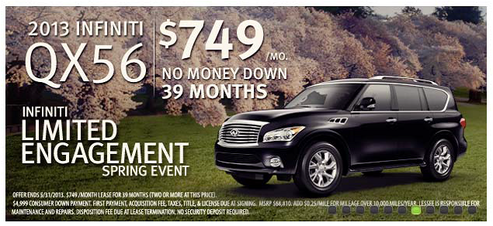
MISSION STATEMENT
If it is a lease, say so!
The disclaimer, literally hidden in the weeds of the ad,
revealed that the apparent sales offer was actually a lease offer.

Slide 14
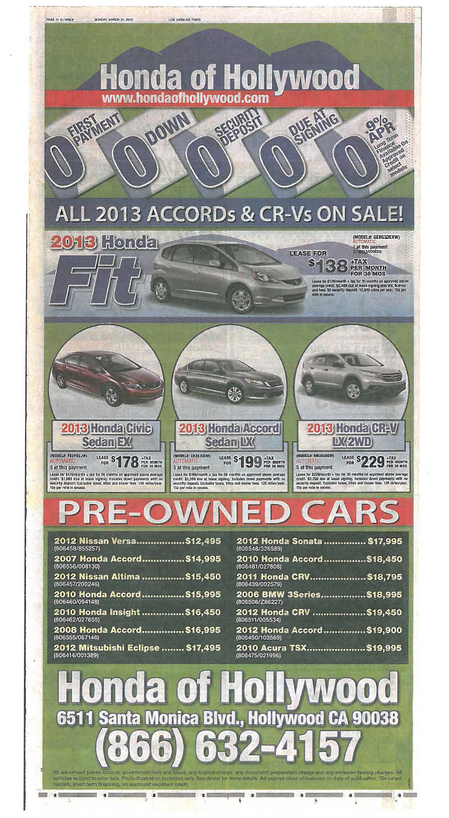
LEASE DISCLOSURES
Lease Disclosures
Small print below each featured vehicle states that consumers must pay a substantial amount at lease signing for that vehicle.
Notes:
For example, the amounts due at lease signing for the four vehicles featured range from $1,995 to $2,499. Thus, consumers must pay substantially more than the “0 DUE AT SIGNING” that is prominently stated at the top of the advertisement.

Slide 15
LEASE DISCLOSURES
Getting it right, Proper Disclosures:
That the transaction advertised is a lease.
The total amount due prior to or at consummation or by delivery, if delivery occurs after consummation.
Whether or not a security deposit is required.
The number, amount, and timing of scheduled payments. No deceptive teaser rate!
With respect to a lease in which the liability of the consumer at the end of the lease term is based on the anticipated residual value of the property, that an extra charge may be imposed at the end of the lease term.

Slide 16
LEASE DISCLOSURES
Lessons learned
Unfair & Deceptive Disclosure Tactics
Saying that your vehicles are less expensive than
competitors when they are not;
Encouraging consumers to repay over a longer period of time than specified in the contract or in the consumer’s interest;
Using disclosures that differ from contractual documents;
Advertising a misleading interest rate; and
Use of Triggering terms without appropriate disclosures

Slide 17
LEASE DISCLOSURES
Prizes and Promotions
The Office of the Attorney General has seen a recent uptick in consumer complaints regarding direct mailers & prizes and promotions run by various dealers throughout Washington.
These complaints encompass many violations but many include violations of RCW 46.70.180(1) and WAC 308-66-152; RCW 19.170; the Prizes and Promotions Act; and RCW 19.240.005.

Slide 18
LEASE DISCLOSURES
Prizes and Promotions;
Mandatory Disclosures
Name and address of sponsor and promoter
Retail value of each prize
The odds to win in immediate proximity to prize
Whether winner must attend presentation or pay any money to claim prize (disclosure must be in a size equal or greater than prize claim)
All material limitations of offer
Include “no purchase necessary,” “a purchase will not increase your odds of winning” in a clear and conspicuous manner

Slide 19
LEASE DISCLOSURES
Prizes and Promotions;
Mandatory Disclosures
Do not imply offer is “free,” if any money must be spent to receive item
You must state on the first page of the offer if a winning ticket must be presented to receive a prize
A person on whose behalf a promotion is being conducted to sell their goods (i.e. the dealer)
The person conducting the promotion (i.e. sales team or direct mailer business)

Slide 20
LEASE DISCLOSURES
Prizes and Promotions;
Mandatory Disclosures
If receipt of a prize is contingent upon any restriction or qualification, you MUST:
Disclose the restriction/qualification in the immediate proximity ,
on the same page with the first listing of the prize ,
in a typeface as large the typeface in the standard text.
OR;

Slide 21
LEASE DISCLOSURES
Prizes and Promotions;
Alternative Disclosures
Make the following statement in typeface at least as large as the standard text:
“Details and qualifications for participation in this promotion may apply and can be found at ______________”
Restrictions must be printed in typeface at least as large as the standard text of the offer.

Slide 22
LEASE DISCLOSURES
Implied Warranty of Merchantability
A dealer’s obligation under state law RCW62A.2-314 requires that every used car sold by a dealer in Washington for a customer’s personal use has an “implied warranty of merchantability.”
This means:
The car will be fit for ordinary driving purposes,
The car will be reasonably safe, without major defects, and
The car will be of the average quality of similar cars available for sale in the same price range.

Slide 23
LEASE DISCLOSURES
Implied Warranty of Merchantability
A car can only be sold without the implied warranty if the customer knowingly agreed to waive the warranty and was provided with a statement of the particular characteristics or parts of the car that are not covered.
Absent the required disclosures and your customer’s explicit consent, an “As Is” sticker in the window of a car or a signed waiver is not sufficient to waive the implied warranty.

Slide 24
LEASE DISCLOSURES
Implied Warranty of Merchantability
The implied warranty can’t be waived under any circumstance if a written warranty is offered with the car or the customer purchases an extended service warranty from the dealer within 90 days of buying a used car.
Communicate all promises in writing

Slide 25
LEASE DISCLOSURES
Implied Warranty of Merchantability
Whatever the warranty status, dealers shouldn’t sell cars that, due to defective or missing safety equipment, aren’t legal to drive on public roads. Here are some general guidelines for meeting your obligations under state law:
Washington consumers have a right to trust that any purchased vehicle will be reasonably safe, efficient and comfortable.

Slide 26
LEASE DISCLOSURES
Implied Warranty of Merchantability
If a customer has major problems with the vehicle, then the dealer may be obligated to meet the customer’s request for repairs or repayment of the purchase price.
Courts have ruled that the implied warranty is legally waived only if both of the following conditions are met:
The consumer explicitly negotiates and agrees to the fact that the car does not have an implied warranty, and the dealer gives the consumer a statement of the particular characteristics or parts of the car which are not being warranted.

Slide 27
LEASE DISCLOSURES
Implied Warranty of Merchantability
Washington court decisions:
The use of an “As Is” sticker does not circumvent the Implied Warranty of Merchantability rules.
A signed, pre-printed form may not be evidence of explicit negotiation.
A clause waiving the warranty in a preprinted sales agreement is not evidence of explicit negotiation.
The burden is on the dealer to prove evidence of an effective disclaimer or waiver of a warranty.

Slide 28
LEASE DISCLOSURES
Implied Warranty of Merchantability
If a customer buys an extended service warranty contract within 90 days of buying the used car, the implied warranty of merchantability cannot be waived under any circumstances-even if previously negotiated.

Slide 29
LEASE DISCLOSURES
Warranty of Fitness for a Particular Purpose RCW 62A.2-315
Used cars have an implied warranty called “Warranty of Fitness for a Particular Purpose.”
A warranty is created if:
The seller knows the vehicle is going to be used for a particular purpose i.e. racing or towing a trailer, and the buyer is relying on the seller’s expertise to provide a suitable vehicle that will actually be fit for that purpose.

Slide 30
LEASE DISCLOSURES
Printed Advertisements
Disclosures in a print advertisement must be made in a type size that is sufficiently large to be read with reasonable ease and must be made in relatively close proximity to each of the terms that require such disclosures.
Disclosures must be made in a color and contrast so as not to obscure other words or pictures appearing in the advertisement. WAC 308-66-152(3)(a)(iii).

Slide 31
LEASE DISCLOSURES
Printed Advertisements
We recommend a typeface of 10 point or larger for all fine print disclosures and that the dealer avoid white typeface on a light blue background unless the typeface is enlarged to ensure that the disclosure is clear and conspicuous.

Slide 32
LEASE DISCLOSURES
Advertising Lightning Round
We recommend that dealers regularly review all advertising on every medium to ensure you are meeting the letter and the spirit of the law. Some of the most common specific violations we see are as follows:

Slide 33
LEASE DISCLOSURES
Advertising Lightning Round
Deceptive pricing
Do not seek to lure prospective buyers onto the lot by advertising vehicles at a low price and then charge them more when they try to buy the car. You cannot sell a car for a price higher than it was advertised.

Slide 34
LEASE DISCLOSURES
Advertising Lightning Round
Deceptive teaser payments
Do not advertise attention-grabbing low monthly payments unless you plan to actually offer the vehicle for that amount. Do not offer temporary teaser payments that will be raised after a short period unless:
The dealer clearly and conspicuously states the number of payments and how much they would be after those first few low monthly payments.

Slide 35
LEASE DISCLOSURES
Advertising Lightning Round
Undisclosed balloon payments
Do not advertise low monthly payments without clearly and conspicuously disclosing how much buyers will owe a final balloon payment.

Slide 36
LEASE DISCLOSURES
Advertising Lightning Round
Patriot Act deception
While consumers must provide identifying information to buy a car for more than $10,000 in cash, they do not need to allow the dealer to run a credit report if they are not financing the purchase. Under federal law, a dealer must have a permissible purpose to run a credit report, and we recommend that the dealer must fulfill this obligation by getting a consumer's permission to run his or her credit report and the request for the credit report must be related to the consumer’s request for credit.

Slide 37
LEASE DISCLOSURES
Advertising Lightning Round
Patriot Act deception
Some dealers falsely tell consumers the Patriot Act requires them to run a credit report (even when there is no request for financing) on them to screen out possible terrorists. This is an unfair and deceptive act and a violation of the law.

Slide 38
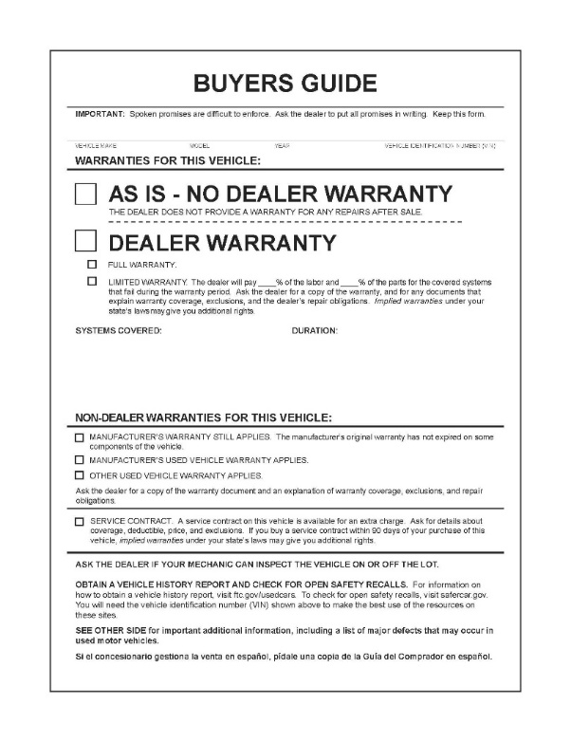
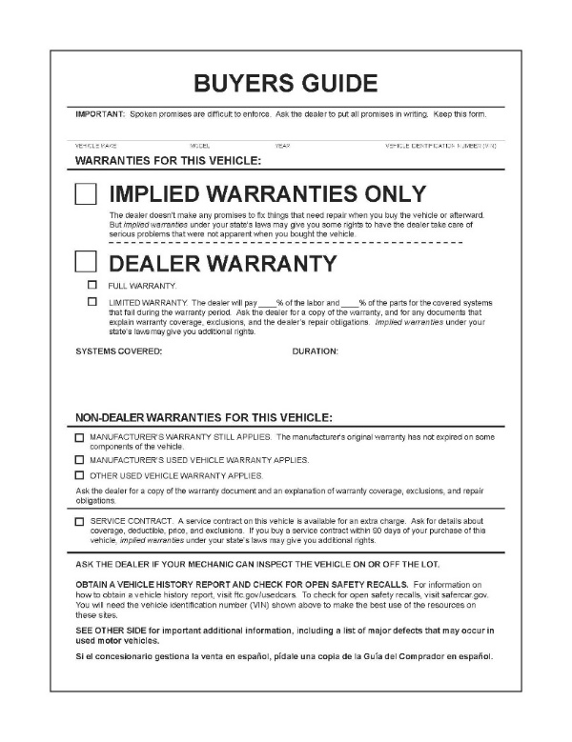
LEASE DISCLOSURES
Advertising Lightning Round
Implied Warranty of Merchantability
What Buyers Guide are you using? If you are using the “As Is” Buyers Guide, and the advertised prices of used vehicles are contingent upon the consumer’s waiver of the implied warranty of
merchantability & fitness for a particular purpose, how is the consumer clearly and conspicuously notified of this material fact in the advertisement?

Slide 39
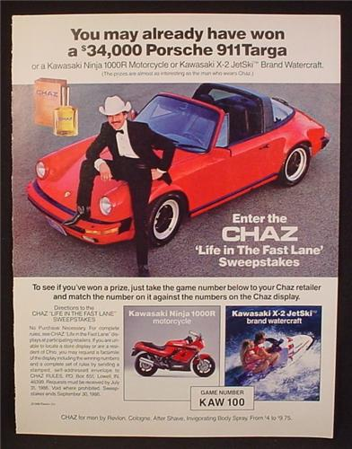
LEASE DISCLOSURES
AGO Advertising Compliance
The AGO regularly reviews advertising on TV, newspapers, radio, and online. We review all claims about sales, financing, and leasing.

Slide 40
LEASE DISCLOSURES
How can I promote best practices?
Strong policies
Clear scripts for internet, radio & TV
Strong oversight, auditing, and monitoring of advertising
Strong training for staff

Slide 41
LEASE DISCLOSURES
Thank you..
..to the Washington State Independent Auto Dealers Association for inviting me to present today.

